Slide 1
Operating Systems
6. File Manager / File Management Layer
PART 1
Dr. Cristina Muntean
cmuntean@ncirl.ie

Slide 2
Topics covered in this lecture
The objectives of the File Management Layer (File Manager)
How each of those objectives is achieved
Various options for the organisation of secondary storage
Unix File Management System (Part 2)
Hardware

Slide 3
6.1 Objectives of the File Manager
Storage and maintenance of information on the secondary storage (e.g. hard disks, floppy disk, etc)
Note: primary storage is the memory
It provides long-term storage!
Sharing of information
It organises the data and allows access to it in a way convenient to the user (e.g. file)
Provide I/O support for a variety of storage device types
Provide I/O support for multiple users
Minimise or eliminate the risk for lost or destroyed data

Slide 4
6.1 Objectives of the File Manager
Minimum set of requirements a File Manager is expected to meet:
Each user should be able to create, delete, read and change files
Each user may have controlled access to other users’ files
Each user may control what type of accesses are allowed to the user’s files
Each user should be able to move data between files
Each user should be able to back up and recover the user’s files in case of damage
Each user should be able to access the user’s files by using symbolic names

Slide 5
6.1 Objectives of the File Manager
What is a File?
A collection of data that is regarded by a user as a single entity.
It is stored on a device (e.g. hard drive, CD)
It is of variable size
The medium on which the files are stored is divided into blocks (512 to 4096 bytes).
File Manager allocates an appropriate number of blocks to each file.
File Attributes
File name (it is unique)
Date of creation, last read, last modified
Protection and authorisation
File size
File type
Location (where on the disk)

Slide 6
6.1 Objectives of the File Manager
Storage Device
Storage Device Organisation
Each storage device (e.g. hard drive, floppy disk, CD, DVD) consists of one or more disks (platters)
Each platter consists of a number of tracks
Each track consists of a number of sectors (or blocks)

Slide 7
6.1 Objectives of the File Manager
Storage Device
Storage Device Properties
Capacity
Number of platters, number of tracks/platter, number of sectors/track, sector size
Speed
Rotation latency (get to the right sector, 5400, 7200,9600 RPM (rotations per minute)
Arm seek (get to the right track, 1-20 msec)
Data transfer (read or write, MB/sec)
Disk read & write are done in sectors! => cannot read or write a single byte

Slide 8
6.1 Objectives of the File Manager
File Manager provides
directories for organising files.
a spectrum of commands
create or delete a file
to read and write the contents of a file,
to change the ownership,
to list files in a directory, to remove a file, etc.
a file protection mechanism
sharing of files among users but prevent unauthorised access

Slide 9
6.1 Objectives of the File Manager
Criteria for Files organisation
Rapid access to a record (file)
Ease to update a file
Economy of storage
Should be minimum redundancy in the data
Simple maintenance
Reliability

Slide 10
6.2 File Manager: Organising Files
Solutions for organising Files and/or Directories
1. Simple Structure
List of entries, one for each file
Sequential file with the name of the file serving as the key
Disadvantages:
Provides no help in organising the files ( e.g. no folders/directories)
Forces user to be careful not to use the same name for two different files

Slide 11
6.2 File Manager: Organising Files
Solutions for organising Files and/or Directories
2. Two-level Structure
One directory for each user and a master directory
Master directory contains entry for each user
Provides address and access control information
Each user directory is a simple list of files for that user
Disadvantage:
Still provides no help in structuring collections of files

Slide 12
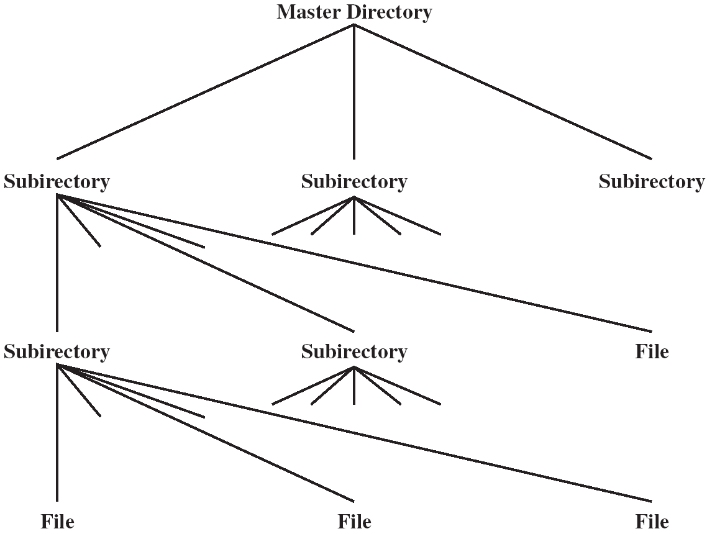
6.2 File Manager: Organising Files
Solutions for organising Files and/or Directories
3. Hierarchical or Tree like Structure
Master directory with user directories underneath it
Each user directory may have subdirectories and files as entries
File directory is divided into two levels:
Master File Directory ( MFD)
User File Directory

Slide 13
6.2 File Manager: Organising Files
Tree like Structure
Master File Directory (MFD)
Contains a listing of all directories on disk
Each user has his own directory and each directory has a unique index number associated with it
=> MFD contains a pointer for each user in the system to a User File Directory (UFD).

Slide 14
6.2 File Manager: Organising Files
Tree Structure
User File Directory (UFD)
Contains the names and locations of the user’s files.
Full name of a file is regarded as the user name concatenated with the file name.
Different users may have files with the same name.
E.g. A user (USER1) can find his/her own MYFILE.TXT by referring to it as such.
The file manager assumes the userid in front of the name to map to the exact physical location.
Information in the UFD would be
the file name
the physical location of the file
The file type ( e.g. character, binary, executable , library etc)
Program used to operate on the file
Access control information ( e.g. read only )
Admin information (e.g. time of last update, last copy taken)

Slide 15
6.2 File Manager: Organising Files
Tree Structure
May be more than two levels deep.
Disadvantages:
the length of the path to a file
the number of disk accesses required in order to follow the path through the various directories.
Improve things a bit with the concept of the ‘current directory’.
Assume individual file names refer to the current directory. To change the current directory you must specify a full path and file name.

Slide 16
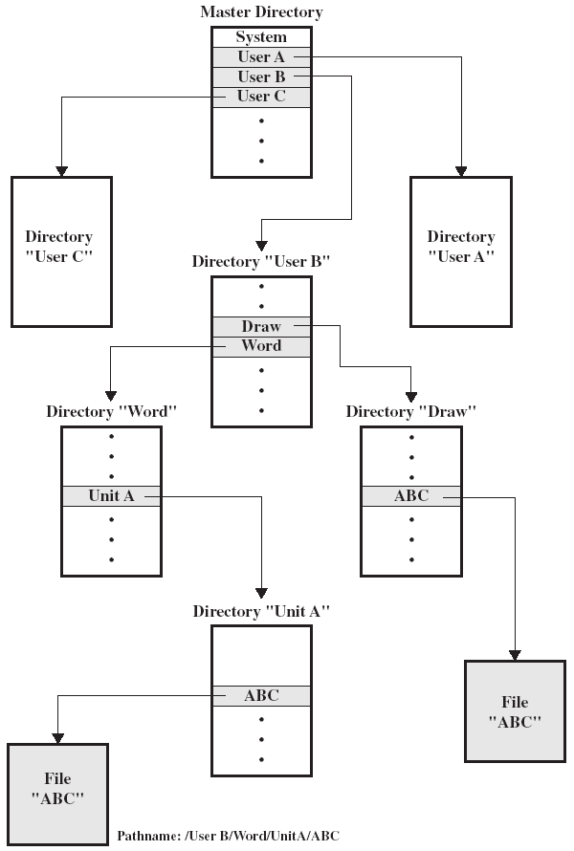
6.2 File Manager: Organising Files
Example of Hierarchical or Tree Structure
Master File Directory (MFD) with user directories underneath it
Each user directory (UFD) may have subdirectories and files as entries
Files can be located by following a path from the root, or master, directory down various branches
This is the pathname for the file
Can have several files with the same file name as long as they have unique path names
Pathname:
/ User B / Word / Unit A / ABC
Stallings Fig 12.5

Slide 17
6.2 How are File Manager’s Objectives Achieved?
File’s Access. Sharing and Security
In a multi-user system, File sharing implies files are accessible to users other than the owner.
Two issues
Access rights
Management of simultaneous access
When files are to be shared need to specify:
which users are allowed to access the files
what kind of access is permitted.
File Manager allows an owner to specify what kind of access is permitted. This is achieved by using a protection mask associated with each file.

Slide 18
6.3 File Manager: File’s Access
Sharing and Security
User classes defined within the File Manager
Owner (O)
Group members ( G)
Others ( rest of the world) ( W)
Types of access privileges that are associated with a file
None
User may not know of the existence of the file
User is not allowed to read the user directory that includes the file
Read ( R)
The user can read the file for any purpose(e.g. copying, execution)
Write ( W)
The user can modify, delete, and add to the file’s data
Execute ( E)
The user can load and execute a program but cannot copy it

Slide 19
6.3 File Manager: File’s Access
Sharing and Security
Owners
Has all rights previously listed
May grant rights to others using the following classes of users
Specific user
User groups
All for public files
Example: When a new file is created it might be assigned a mask as follows: O:RWE, G:RW, W:R.
It means that:
Owner has all privileges - can do anything
Users within the same group as the owner can read and write
Others can Read.

Slide 20
6.4 Organisation of Files on the Secondary Storage
Files are stored on the secondary storage
e.g. hard disk, CD, diskette, DVD, etc.
These storage devices are divided into blocks
Size of one block: 512 to 4096 bytes
Operating System’s File Manager allocates an appropriate number of blocks to each file in order to store the data.

Slide 21
6.4 Organisation of Files on the Secondary Storage
Numerous ways of organising blocks within a file. Four of them are considered here:
1. Contiguous files
2. Block linkage
3. Index blocks
OS may use a combination of these for different circumstances
e.g. different media – DVD, CD, hard disk.

Slide 22
6.4 Organisation of Files on the Secondary Storage
1. Contiguous Files
How it works?
A single set of blocks is allocated to a file at the time of creation
Data in a file is stored in a contiguous section of the disk
=> The file occupies a linear sequence of disk blocks
User File Directory (UFD) holds for each file:
the file name
start block number
the file size
Free space
Each set of consecutive blocks that are not used by a file forms a separate free space

Slide 23
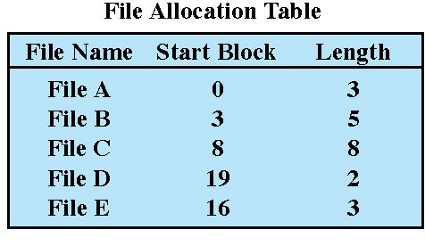
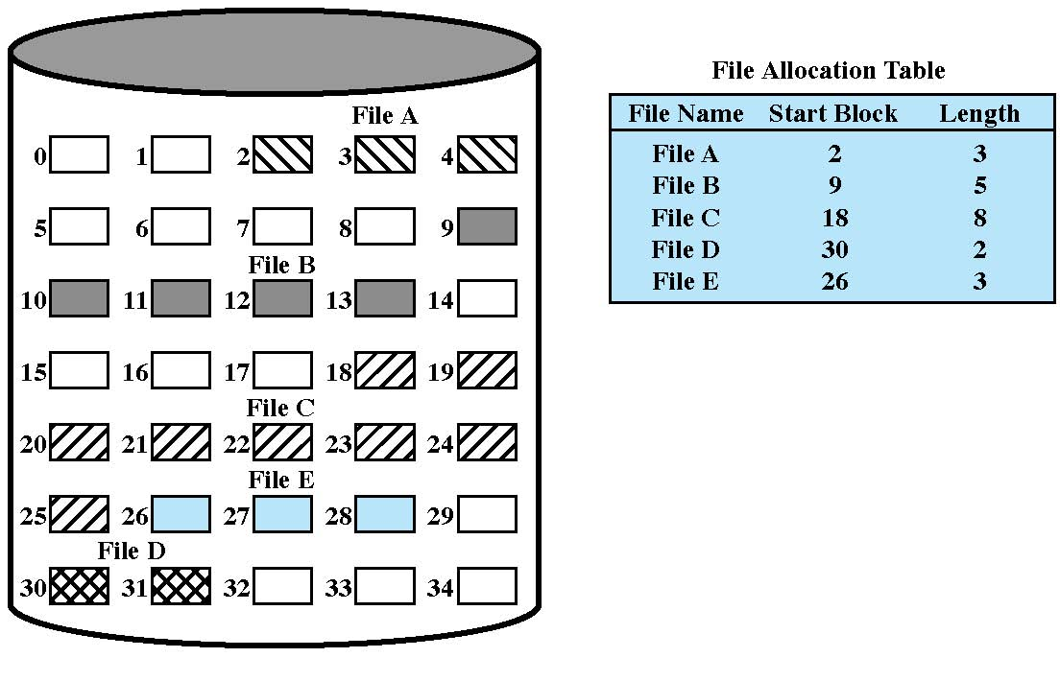
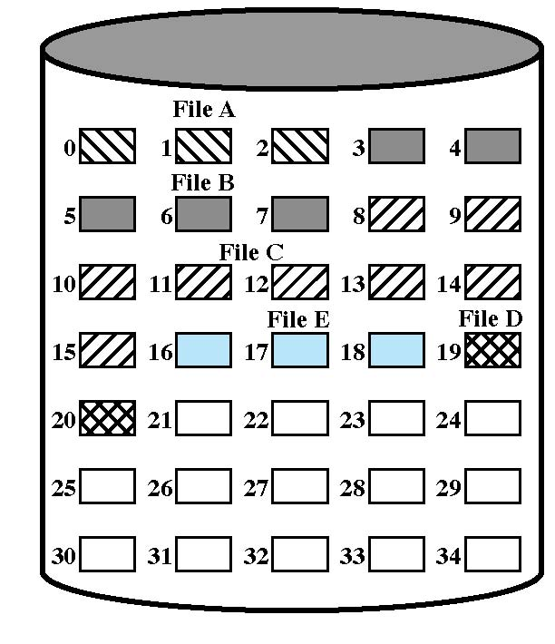
6.4 Organisation of Files on the Secondary Storage
1. Contiguous Files
External fragmentation may occur
➔ compaction needed
Contiguous File Allocation (Stallings Fig 12.7)
Contiguous File Allocation (After Compaction) (Stallings Fig 12.8)‏

Slide 24
6.4 Organisation of Files on the Secondary Storage
1. Contiguous Files
Advantages
Simple to implement
Fast Read and Write operations
Damage to a block results in loss of data only on that block
Allows linear and sequential access with the same ease
Disadvantages
Fragmentation of the disk space can occur => compaction is required
Compaction requires exclusive use of the file system for an extended time. This is a time consuming process!
Does not allow simple expansion of files. How do you allocate space at the start when you don’t know how the file is going to grow

Slide 25
6.4 Organisation of Files on the Secondary Storage
2. Block linkage
How it works?
Sectors belonging to the same file form a linked list
Data blocks of a file can be scattered anywhere on the disk
UFD holds for each file:
the file name
start block number
Each data block uses some bytes of its space for a pointer to the next block of the file. This continues until the last block that has a special end-of-file (EOF) value.
Free space
A list of free blocks
Blocks that become free are added at either end of the list

Slide 26
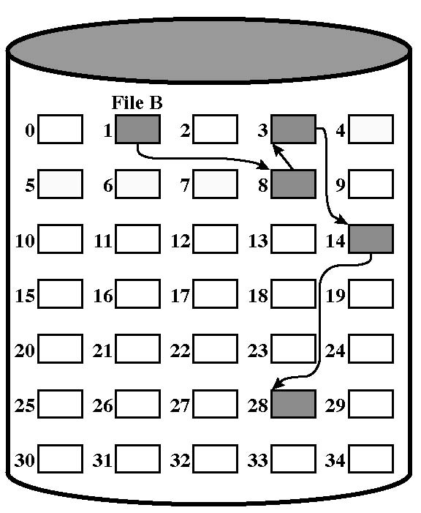
6.4 Organisation of Files on the Secondary Storage
2. Block linkage
File Allocation Table
File Name Start Block
. . . . . .
File B 1
. . . . . .
Block linkage (Stallings Fig 12.9)‏
EOF Value

Slide 27
6.3 Organisation of Secondary Storage
2. Block linkage
Advantages
Reasonably simple to implement
Files can grow and shrink with no problems
No need to declare the file size when the file is first created
No fragmentation => no need to compact free space
Small overhead per block ( pointer to next block )
Disadvantages
Large number of accesses to find end of file
Deletion of file requires large number of accesses
Only sequential access is possible
Damage to a block means loss of link to next block

Slide 28
6.3 Organisation of Secondary Storage
3. Index Blocks
How it works?
An index block is allocated for each file that is created.
The index block of a file contains all the pointers that point to the data blocks of that file
Index block contains list of blocks for each file
UFD holds for each file:
the file name
the index block number
Free space
An index block of free blocks
Pointers to the blocks that become free are added at the end of the index block of the free space

Slide 29
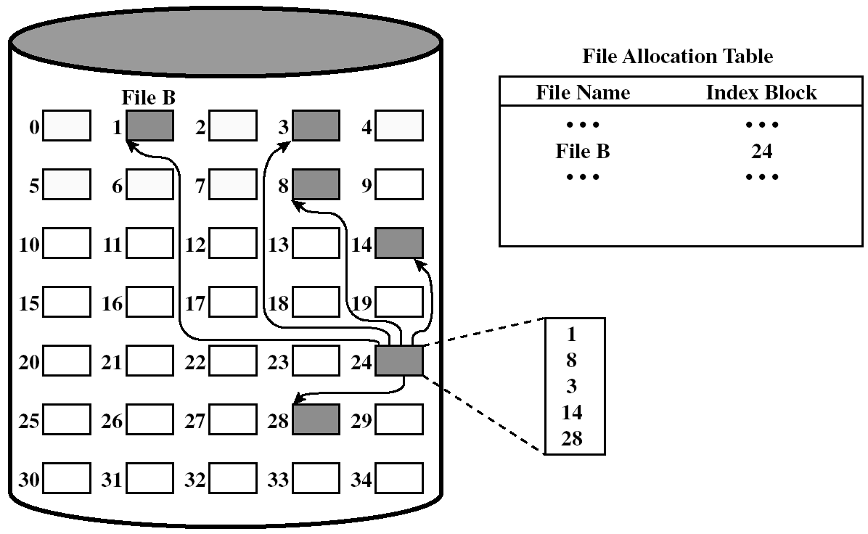
6.3 Organisation of Secondary Storage
3. Index Blocks
Indexed Blocks Allocation (Stallings Fig 12.11 )‏

Slide 30
6.4 Organisation of Files on the Secondary Storage
3. Index Blocks
Advantages
File can be accesses randomly specifying file name and offset in index block
Direct-access to the data is efficient. The 'i'th entry in the index block points to the 'i'th block of the file
Disadvantages
An entire disk block must be allocated to hold the pointers. Overhead of index blocks
dis-proportionately large for small files
Addition or deletion of blocks in the middle of the file requires rearrangement of pointers
Damage to an index block results in severe data

Slide 31
6.4 Organisation of Files on the Secondary Storage
Free Space Management
Regard free space as a file in its own right and handle it under one of the 3 methods above.
The simplest method is to have a bit map representing the disk which shows which blocks are free.
Other solutions: same techniques used for organising blocks within a file
Free blocks linkage
Index of Free Blocks
Free Block List (similar with Contiguous Files technique)

Slide 32
Learning Outcome
After this lecture, you should have an understanding of the File Management Layer (File Manager) of a typical Operating System.
Which are the objectives?
Sharing and security regarding file access
You should know about :
Three methods/structures of organising the files and the advantages and disadvantages of each.
Simple structure / two level structure/ Hierarchical structure
3 solutions for organising blocks within a file and the advantages and disadvantages of each.
Contiguous file/ block linkage and linked blocks

